Slide 1
MYCOBACTERIUM TUBERCULOSIS
DR.T.AJAYAN
PROF. & HOD
PRACTICE OF MEDICINE

Slide 2
Distribution statistics
1/3 of world’s population is infected with TB
8 Million people develop active TB every year
TB kills more young women than any other disease
More than 100,000 children will die from TB this year
Hundreds of thousands of children will become TB orphans

Slide 3
TB is an infectious disease that affects mainly the lungs (pulmonary TB or PTB) but can also attack any part of the body (extra-pulmonary TB or EPTB)
A person with PTB is infectious to others!

Slide 4
MYCOBACTERIA
SLENDER RODS
MYCOBACTERIA-MEANING FUNGUS-LIKE BACTERIA
ACID FAST BACILLI
AEROBIC
NONMOTILE
NONSPORING
NON CAPSULATED

Slide 5
MYCOBACTERIUM TUBERCULOSIS
STRAIGHT OR SLIGHTLY CURVED ROD
OCCURING SINGLY’ IN PAIRS OR AS SMALL CLUMPS
TUBERCULOSIS IN HUMANS IS CAUSED BY TWO TYPES
HUMAN
BOVINE

Slide 6
THE STAINS IMPART DIFFERRENT COLOURS TO DIFFERENT BACTERIA OR BACTERIAL STRUCTURE
GRAM STAIN
ACID FAST STAIN

Slide 7
GRAM STAIN
PRIMARY STAINING WITH A DYE
APPLICATION OF DILUTE SOLUTION OF IODINE
DECOLOURISATION WITH AN ORGANIC SOLVENT
COUNTERSTAINING WITH A DYE OF CONTRASTING COLOUR

Slide 8
GRAM POSITIVE&GRAM NEGATIVE
RESIST DECOLOURATION AND RETAIN THE PRIMARY STAIN, APPEARING VIOLET
DECOLOURISED BY THE ORGANIC SOLVENT SO HAVE THE COUNTER STAIN, APPEARING RED

Slide 9
ACID FAST STAIN
SMEAR IS STAINED WITH SRONG SOLUTION OF CARBOL FUCHSIN WITH APPLICATION OF HEAT
DECOLOURISED WITH 20% SULPHURIC ACID
COUNTERSTAINED WITH METHYLENE BLUE

Slide 10
ACID FASTNESS IN M. TUBERCULOSIS
LIPID –RICH WAXY CELL WALL
SEMIPERMEABLE MEMBRANE AROUND CELL

Slide 11
FROM EXPOSURE TO INFECTION
SOURCE OF INFECTION-OPEN CASE OF PULMONARY TUBERCULOSIS
MODE OF INFECTION-
BY DROPLET NUCLEI, WHICH ARE AEROSOLIZED BYCOUGHING’ SNEEZING, OR SPEAKING.3000 INFECTIOUS NUCLEI PER COUGH
INGESTION

Slide 12
DETERMINANT OF TRANSMISSION
PROBABILITY OF CONTACT WITH A CASE OF TUBERCULOSIS
INTIMACY AND DURATION OF CONTACT
DEGREE OF INFECTIOUSNESS OF THE CASE
SHARED ENVIORNMENT OF THE CONTACT
INFECTION IS DETERMINED BY EXOGENOUS FACTOR

Slide 13
Transmission
Pulmonary tuberculosis is a disease of respiratory transmission, Patients with the active disease (bacilli) expel them into the air by:
coughing,
sneezing,
shouting,
or any other way that will expel bacilli into the air

Slide 14
Once inhaled by a tuberculin free person, the bacilli multiply 4 -6 weeks and spreads throughout the body. The bacilli implant in areas of high partial pressure of oxygen:
lung
renal cortex
reticuloendothelial system

Slide 15
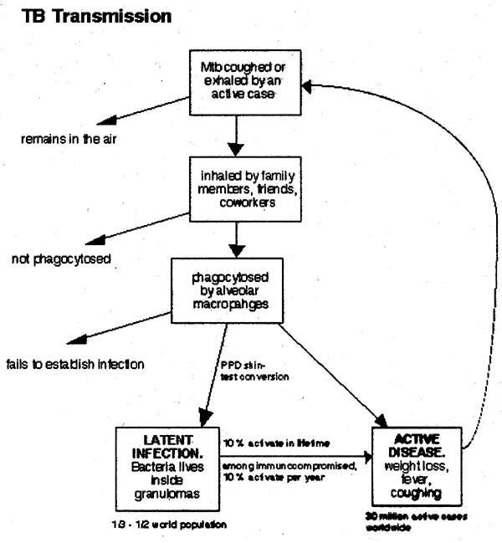

Slide 16
TRANSMISSION
Lungs
Inhalation of droplet nuclei
Coughing: 3000
droplet nuclei/cough
Talking: 5 minutes
Sneezing: BEST

Slide 17
Contd..
Person to person
via
Airborne transmission
in
Confined environment

Slide 18
FROM INFECTION TO DISEASE
ENDOGENOUS FACTORS-INDIVIDUAL INNATE SUSCEPTABILITY TO DISEASE,LEVEL OF FUNCTION OF CELL-MEDIATED IMMUNITY

Slide 19
DISEASES FAVOR THE DEVELOPMENT OF ACTIVE TUBERCULOSIS
HIV
SILICOSIS
LYMPHOMA
LEUKEMIA
OTHER MALIGNANT NEOPLASM
HEMOPHILIA
CHRONIC RENAL FAILURE AND HEMODIALYSIS
IDDM
IMMUNOSUPPRESSIVE TREATMENT

Slide 20
PRESENCE OF OLD , SELF-HEALED ,FIBROTIC TUBERCULOUS LEISONS IS A SERIOUS RISK OF ACTIVE DISEASE

Slide 21
SPREAD
LOCAL
LYMPHATIC
HAEMATOGENOUS
BY NATURAL PASSAGES

Slide 22
PATHOGENESIS
MAJORITY OF INHALED BACILLI ARE TAPPED IN THE UPPER AIRWAYS AND EXPELLED BY THE CILIATED MUCOSAL CELLS, A FRACTION REACH ALVEOLI .

Slide 23
TUBERCLE BACILLI DO NOT CONTAIN OR SECRETE TOXIN.THE EXACT BASIS OF VIRULENCE IS NOT UNDERSTOOD, SEEMS TO BE RELATED TO THEIR ABILITY TO SURVIVE AND MULTIPLY IN MACROPHAGES

Slide 24
CELL MEDIATED IMMUNITY IS EFFECTIVE WHILE HUMORAL IMMUNITY IS IRRELAVENT

Slide 25
PHAGOCYTOSIS
BACTERICIDAL ACTIVITY OF MACROPHAGE
VIRULENCE OF BACILLI(LIPID RICH CELL WALL& GLYCOLIPID CAPSULE)

Slide 26
INTIAL STAGE OF INFECTION
IN THE INITIAL STAGE HOST’S MACROPHAGES CONTAIN BACILLARY MULTIPLICATION
BACILLARY GROWTH KILL THE MACROPHAGES
NON ACTIVATED MONOCYTES ARE ATTRACTED TO THE SITE BY VARIOUS CHEMOTACTIC FACTORS , WHICH INGEST THE BACILLI RELEASED FROM THE LYSED MACROPHAGES. THIS STAGE IS ASYMPTOMATIC.

Slide 27
2 TO 4 WEEKS AFTER INFECTION
TWO ADDITIONAL HOST RESPONSE
TISSUE DAMAGING RESPONSE
MACROPHAGE –ACTIVATING RESPONSE

Slide 28
EVENTS INITIATE THE 2 HOST RESPONSES
MACROPHAGE DIGEST SOME OF THE BACTERIA TO RELEASE THE ANTIGEN.ANTIGENS ARE SUBSTANCE WHICH INDUCE SPECIFIC IMMUNE REACTIONS IN THE BODY.THEY ARE DIGESTED INTO POLYPEPTIDE . THIS POLYPEPTIDE ALONG WITH MHC ACTIVATE THE CD4+ HELPER T LYMPHOCYTE , CAUSES THE RELEASE OF CYTOKINES WHICH INDUCE THE 2 HOST RESONSES.

Slide 29
ACTIVATION OF CD4+ HELPER T CELL
BY 2 PATHWAYS-
TH- 1 CELLS
TH-2 CELLS
TH- 1 CYTOKINES(IFN-ϒ, IL-2) ACTIVATE MACROPHAGES RESULTING IN PROTECTIVE IMMUNITY AND CONTAINMENT OF INFECTION.
TH -2 CYTOKINES(IL-4, IL-5, IL-10) INDUCE DTH, TISSUE DESTRUCTION AND PROGRESIVE DISEASE

Slide 30
TISSUE –DAMAGING RESPONSE
ACCUMULATION OF LARGE NUMBERS OF ACTIVATED MACROPHAGES AT THE SITE OF PRIMARY LEISION , GRANULOMATOUS LEISIONS ARE FORMED.TISSUE-DAMAGING RESPONSE IS THE ONLY EVENT CAPABLE OF LIMITING MYCOBACTERIAL GROWTH WITHIN MACROPHAGES.IT NOT ONLY DESTROYS MACROPHAGES BUT ALSO PRODUCES EARLY SOLID NECROSS IN THE CENTER OF THE TUBERCLE. BACTERIAL GROWTH IS INHIBITED

Slide 31
CELL MEDIATED IMMUNITY
Macrophages are activated and aggregate around the leision’s center and effectively neutralize the bacilli without causing further tissue destruction. In the center of the leision, necrotic material resembles soft cheese. Even when healing takes place bacilli remain dormant in the necrotic material for years or throughout the life time. Healed lesions undergo calcification(ranke complex).

Slide 32
PROGRESSION OF TISUE-DAMAGING RESPONSE
TISSUE DAMAGE.
SURROUNDING TISSUE IS PROGRESSIVELY DAMAGE.
CASEOUS MATERIAL AT THE CENTER OF LEISION, LIQUEFIES.
FORMES CAVITIES.
ERODE THE BRONCIAL WALL AND BLOOD VESSELS.

Slide 33
CYTOKINES
IL 1- FEVER
TNF ά –CONTRIBUTES TO THE KILLING OF MYCOBACTERIA, THE FORMATIONS OF GRANULOMAS, SYSTEMIC EFFECTS SUCH AS, FEVER AND WT. LOSS.

Slide 34
ANTIGENS GIVING PROTECTIVE IMMUNITY
30- kDa
ESAT-6

Slide 35
TYPES
PULMONARY
PRIMARY
POST PRIMARY
EXTRA PULMONARY

Slide 36
CLINICAL FEATURES

Slide 37
i
Symptoms
The symptoms for tuberculosis are:
(These symptoms are ranged from mild to dangerous)
feeling weak or sick all the time
coughs that will not go away
weight loss/loss of appetite
fever/night sweats
chest pain
coughing up blood

Slide 38
cervical

Slide 39
Supra clavicular

Slide 40
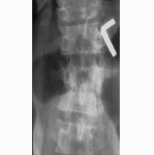
Potts spine

Slide 41
Supra renal tuberculosis

Slide 42
Axillary tuberculosis

Slide 43
Diagnosis
Clinical history
Signs of fever, pleural rub, crackles
Investigations:
X ray chest
intra dermal PPD
Mauntax
ZN staning
PCR
DNA probing

Slide 44
TUBERCULIN TEST
OT WAS FIRST USED BY KOCH IN THE TREATMENT OF TUBERCULOSIS
LATER USED FOR ALLERGIC TESTING BY VON PIRQUET
PARTIALLY PURIFIED PROTEIN ANTIGEN IS INTRODUCED BY SEIBERT.CALLED PPD

Slide 45
MANTOUX TEST
0.1 ml Of ppd containing 5 tu is injected intradermally on the flexor aspect of the forearm with a tuberculin syringe raising a wheel.
Injection should be given between the layers of skin and not subcutaneously.
The site is examined 48-72 hours later and induration is measured at its widest point transversely to the long axis of the arm.
Erythema is not taken into account.

Slide 46
MANTOUX TEST
INDURATION OF DIAMETER 10mm OR MORE IS CONSIDERED POSITIVE,5 mm OR LESS NEGATIVE AND 6-9 EQUIVOCAL. A PPD DOSE OF 1 TU IS USED WHEN EXTREME HYPERSENSITIVITY IS SUSPECTED; AND DOSES OF 10 OR 100 WHEN 5 TU TEST IS NEGATIVE.

Slide 47
WARNING!
Rifampin and Isoniazid are the most effective drugs for the treatment of TB.
These 2 drugs should never be given alone!
They are always used in combination because resistance occurs to one drug alone very rapidly. They are used in combination with each other initially as well as other drugs. Bacilli must become resistant to two drugs in order to remain viable..

Slide 48
prevention
Early detection
Education and screening
Engineering controls
Personal hygiene and isolation of infected cases.

Slide 49
Thank you

